Slide 1
Competency Based Training (CBT&A Methodology) Trainer & Assessor(Level 4)
Day-16
12. Organise and Conduct Competency Based Assessment
DR. Sheikh Abu Reza
Director (Rtd) DTE &
CBT&A Trainer

Slide 2
Organise and Conduct Competency Based Assessment
Prepare the assessment venue.
Prepare the candidate.
Conduct assessment.
Gather evidence.
Make the assessment decision.
Record and report assessment decision.
Provide feedback to the candidate’s.
P-7

Slide 3

Organise and Conduct Competency Based Assessment
PREPARE VENUE
RECORD & REPORT
PREPARE CANDIDATE
PROVIDE FEEDBACK
ASSESSMENT
PROCESS
COLLECT EVIDECE
MAKING JUDGEMENT
VALID
FLEXIBLE
RELIABLE
FAIR
VALID
CURRENT
SUFFICIENT
CONSISTENT
AUTHENTIC
RECENT
DIRECT
VC’S CAR
ORAL
REVIEW/CARS
EVENTS
METHODS
PRINCIPLES
DEMONSTRATION
EVIDECE RULES
C (NC)
NYC/SoA
AUTHENTIC
COCISTENT
COST EFECTIVE
REASONABLE ADJUSTMENT
INDIRECT
WRITTEN
ERROR’S
REASSESMENT
APPEAL
P-49
HALO EFFECT
HORN EFFECT

Slide 4
Prepare the assessment venue
An assessment venue is a place where candidates are examined to determine their suitability for specific types of employment, especially management or military command. The candidates' personality and aptitudes are determined by techniques including interviews, group exercises, presentations, examinations and psychometric testing.
Assessment venue is not just a building for assessing a job candidate, it is a process of evaluation of behavior based on multiple evaluation including: job related simulations, interviews or psychological tests.
Workplace
RTO
P-16

Slide 5
How to Prepare for Assessment Venue
Identify Specialist Support
Sometimes, we will need to get the help of specialist support people. These are the people who can help us to make sure that our assessment is fair for our students. While specialist support is often obtained to assist us when working with candidates who have special needs, this is not the only time that we use specialist support.
Common specialist support services may include:
online assessment strategies
support for remote or isolated candidates or assessors
support from subject matter or safety experts
advice from regulatory authorities
assessment panels
support from lead assessors
advice from policy development experts
third party assistance from a carer or interpreter.
P-16

Slide 6
Preparing for Assessment
On the day of your assessment venue you must:
Arrive in good time.
Be polite to everyone you meet, including other candidates.
Join in with discussions, including informal ones (e.g. during lunch/dinner).
Be assertive during group and individual exercises.
Move on quickly, if you make a mistake. Assessors are not expecting you to be perfect in all areas, so try not to do well on any errors.
Try to draw others into group discussions. Your assessors want to see evidence of good leadership and teamwork skills.
Find out when you can call for interview feedback.
P-17

Slide 7
Assessment Center
An assessment center is a place where candidates are assessed in accordance with assessment guideline. Its only use for assessment not for training.
Resources of assessment venue:
While the resources that we need will depend on the particular context and purpose of assessment, there are some common ones that we should be familiar with:
Information
Documents needed for assessors and candidates, including competency standards and assessment tools
Plant and equipment technology
Personal protective equipment
Venues
Adaptive technology
Physical adjustments to the assessment environment
Additional personnel (including specialist support)
P-18

Slide 8
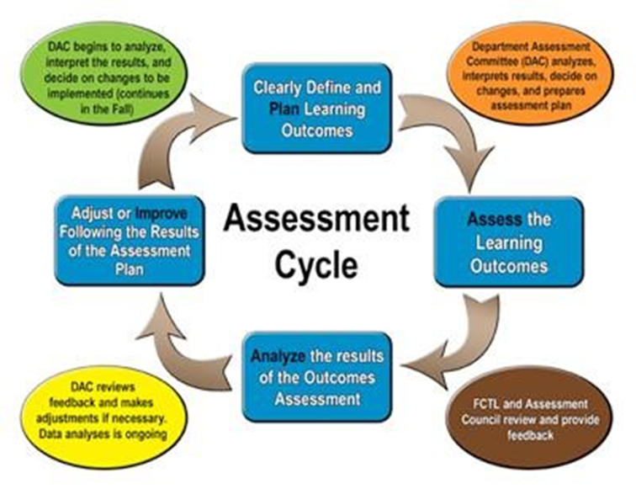
The Four Steps of the Assessment Cycle

Slide 9
When to stop an assessment
Any breach of safety
Equipment breaks down
Trainee becomes stressed or requests to stop
Clear evidence of non competency
Chance of damage to property or equipment
Assessment is having an effect on production (when conducted in a workplace).

Slide 10
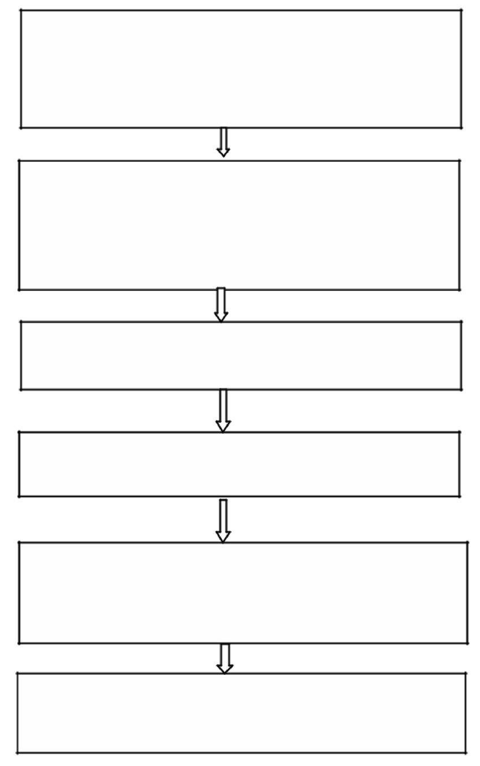
The stages of competency assessment
Prepare candidates
Collect evidence/conduct assessment event
Make assessment decision
Provide feedback candidate
Record & report assessment outcomes to BTEB
Review assessment process

Slide 11
Complete the activity sheets and submit
Attendance Sheet
Self-assessment
Assessment Registration Form
Competency Assessment Agreement

Slide 12
Conduct assessment
Assessment involves working out a number of things:
which standards or objectives are being assessed
which types of evidence are best to collect
which evidence is best for this particular candidate
which evidence is the best indicator of achievement
P-55

Slide 13
Types of assessment
Formative assessment
Summative Assessment
P-55

Slide 14
Details Steps of Assessment Process (CBT&A)
Check the environment & workplace
Introduce with candidate
Ask about for which assessment he came
Self-checklist fill up (By Self Checklist sheet)
Assessment registration Process (By Registration Form If not)
Event declaration to the candidate:
What & how much events (where, time, sequence)
Logistics information
Appeal related information
Agreement document sign with candidate
Written test (By Written questioner)
Describe the question
Instruction
Monitor
Next event information
Demonstration Event
Ensure candidate Inclusive / OSH
Instruction sheet
Job Sheet & Specification Sheet
Demonstration checklist
Interview Event
Individual Interview
Candidate comfort
Oral Questioner Checklist (Contingency technique)
Tell candidate for wait for result
Result Event (CARS given)
Individual Call
Sandwich Method Feedback o Result declared
Given Competency Assessment Result Summary (CARS)
P-56

Slide 15
Questioning
Skillful questioning invites discussion. The following techniques should be observed when questioning a candidate'
Involve the candidate as much as possible and encourage him/her to participate in the discussion.
Avoid ambiguous and unclear questions that may make the candidate feel unsure or confused.
Avoid leading questions that may influence the candidate's response and make the assessment invalid.
Plan the structure and order of questions before the assessment
Use follow-up questions to identify the range and depth of experience of the candidate
Ask the right questions. The way you phrase and ask a question can determine the quality of the information you get
P-44

Slide 16
Errors commonly made by assessors
The halo effect
Failing to record
Failing to observe
Marking down the middle
Overlooking cheating
P-45

Slide 17
Portfolio
A portfolio is a collection of evidence that may be presented to an assessor to prove your competence at a job or task.
What is portfolio evidence?
Training results / certificates
Training workbooks
References from colleagues / employers
Job descriptions / work experience
Photos / videos
Work journal / diary
Awards
Work samples - menus, letters, memos, budgets
P-46

Slide 18
Third party report
Evidence provided by person who has first hand information on candidate performance
Often supplied by person in authority
Useful for verifying assessor observation
Useful in assessing consistency of candidate performance
P-46

Slide 19
Making Assessment Decision
Requirements of the unit of competency
Dimensions of competency
Rules of evidence
Making overall judgement
P-54

Slide 20

The responsibilities of a reviewer
Planning and carrying out review duties effectively, efficiently and ethically
Ensuring that the review process takes into account all necessary legal and safety requirements
Documenting the observations made during the review process
Reporting the review results
Verifying the effectiveness of corrective procedures taken as a result of the review, if requested by the client
Retaining and safeguarding documents pertaining to the review.
P-60

Slide 21
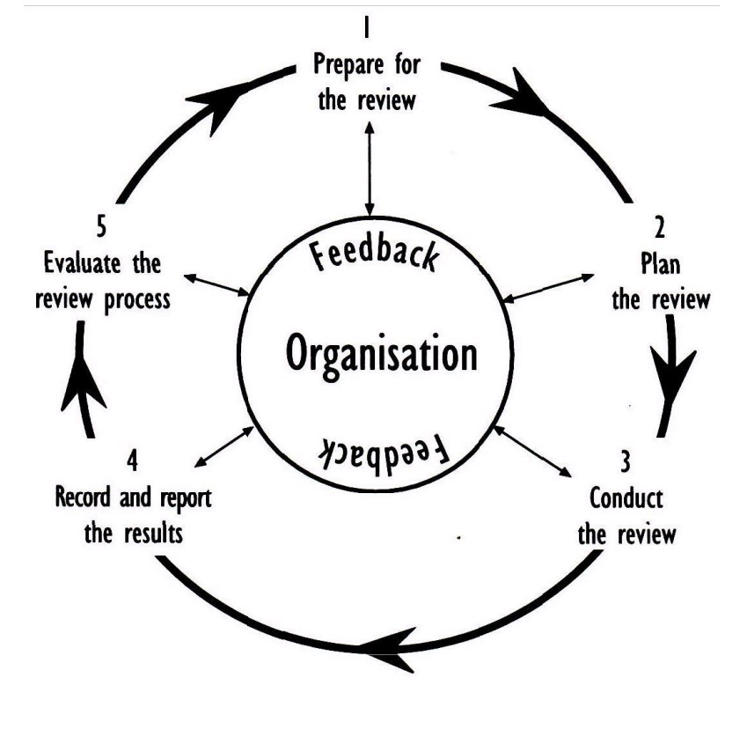
The Review cycle
P-61

Slide 22
Providing Feedback
Feedback
Feedback is not a one way process. Participants gain the most valuable information about their performance by reflecting on it themselves. Encouraging people to self reflect assists them to learn from experience and make positive changes. A good facilitator will also encourage trainees to get feedback from other trainees
Feedback from a facilitator should focus on how a learner can improve. Focus on corrective actions not mistakes.

Slide 23

The value of informative feedback
Formative assessment should be used to improve learning and help the trainee or learner to focus on areas where more study or practice is needed. By providing informative feedback and constructive advice, the assessor should ensure the trainee understands how to overcome any problems or weaknesses.
Even when the trainee has provided evidence of competence, or has achieved the specified learning outcomes, the feedback session can be used to explore the next stage in learning or development.
Self assessment can be used to encourage the trainee to take more responsibility for their own learning. Always ask the trainee how they felt about the assessment before offering your feedback. The trainee's self-esteem should be enhanced by having the opportunity to critically reflect on their own performance.

Slide 24
The feedback sandwich
Kiss | Tell the learner about something positive you have noticed
Kick | Advise the learner of an area that could be improved and how they can do this
Kiss | Finish with an encouraging statement

Slide 25
Approaches to providing feedback
Face to face discussion
Written comments.
Telephone, fax or email communication
Combination of the above mentioned methods.
P-70

Slide 26
Effective ways of providing feedback
Start by asking the candidate to judge how well he/she performed.
Reinforce all the positive aspects of the assessment.
When positive feedback is called for, praise should be spread around freely and it should be as specific as possible. Saying "nice job" isn't good enough.
P-70

Slide 27
Discuss the areas for improvement in detail
Effective feedback should also inform candidate clearly what he/she did well and what needs modification- general comments just as -good work- K, or 'needs improvement.
Discuss the need for further evidence
Inform the candidate of your proposed final decision
Discuss agreement or disagreement with decision
Work out ways in which the gaps from assessment maybe filled
Remind the candidate of the next procedures, e.g. recording information, signing the assessment forms
Ask the candidate how you can improve assessments for future purposes.
P-70

Slide 28
Helpful strategies for feedback on negative assessment
Be positive without raising any false expectations
Be precise about the gaps in the candidate's competence
Identify whether any part(s) of the assessment needs to be repeated and if so, which parts
Emphasize and explain the results "Which competency has been and has not been achieved'?"
Suggest further learning or practice to fix the gaps
Arrange further opportunity for candidate to complete assessment requirements.
P-71

Slide 29
Benefits of providing feedback
Feedback is beneficial both to the assessor and the candidate to provide for the following:
Review/evaluation of assessors performance
Review/evaluation of assessment process and assessment documents
Chance to explain assessment decisions made
Identifying the candidate's strengths and weaknesses
Giving guidance for further training
Encouragement of candidate who has not achieved the required level of competence.
P-71

Slide 30
Review
Prepare the assessment venue.
Prepare the candidate.
Conduct assessment.
Gather evidence.
Make the assessment decision.
Record and report assessment decision.
Provide feedback to the candidate’s.

